Slide 1
Introduction to Mobile Computing
Sipra DasBit
Dept. of Computer Science & Technology
Bengal Engineering & Science University
sdasbit@yahoo.co.in
sb@cs.iiests.ac.in

Slide 2
Summary of Presentation
Introduction
Infrastructure wireless network
      Cellular network
      Infrastructure WLAN
Infrastructureless wireless network
      Mobile Adhoc Network (MANET)
      Wireless sensor Network (WSN)
Conclusion

Slide 3
Introduction
Mobile Computing
  Mobile
    Historically been used to classify any radio terminal that could be moved during operation
    eg. a cellular telephone in a moving vehicle
  Portable
    A radio terminal that can be hand-held and used by someone at walking speed
    eg. a walkie-talkie or cordless telephone inside a home

Slide 4
  Computing
    Computing/ communication on move
    Definition
      Mobile Computing is a generic term describing the application of portable, and wireless computing and communication devices
      eg. devices like laptop with WLAN, mobile phones, PDAs with bluetooth interfaces

Slide 5
Features
  Portability/change of location
  Wireless transmission
  Computing
  Communication

Slide 6
Constraints
  change of resources
  bandwidth fluctuations
  limited memory storage
  new environment configurations
  network disconnection/re-connection

Slide 7
Infrastructure wireless network
Infrastructure mode wireless networking bridges (joins) a wireless network to a wired backbone network
  eg. Cellular network – wireless network comprising of mobile clients is connected with a backbone of BSs, MSCs, PSTN/ISDN etc.
  eg. Wireless local area network (WLAN)– wireless network comprising of Laptops, PDAs etc. is connected with wired backbone through access points (APs)

Slide 8
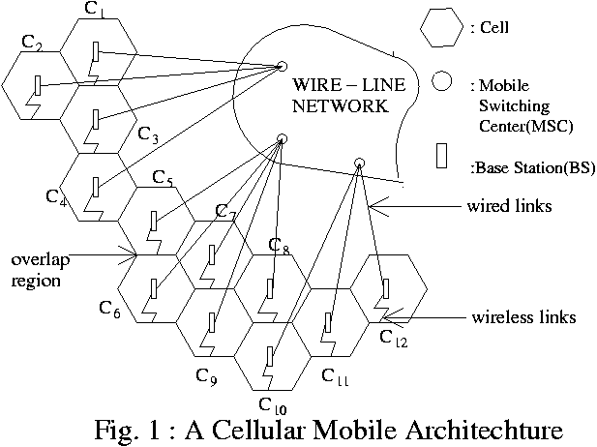

Slide 9
Cellular network
Cellular architecture is conceived as a collection of geometric areas called cells
Each cell is serviced by a base station (BS) located at its centre
Each BS is linked to a mobile switching centre (MSC)
The MSC acts as a gateway of the cellular network

Slide 10
Challenges
Location tracking
Load balancing
Query processing

Slide 11
Location Tracking
Tracking down a mobile user/ unit (MU) needs to be correctly determined in order to route an incoming call
Location tracking/mgt involves two kinds of activities
    paging
    update
Consumes scarce resources
    wireless network bandwidth
    mobile equipment power

Slide 12
Location Tracking
Incurs a significant cost
To route a call
    User is paged simultaneously in the whole network
    MS sends its current profile periodically

Slide 13
Load Balancing
Remarkable growth of the mobile users
Distribute channels amongst the cells in a balanced way to reduce call block
Very limited frequency spectrum allocated to this service
Frequency reuse is needed
Concept of co-channel cells is used as a solution

Slide 14
Load Balancing
Channel allocation
  Each BS is allocated a portion of the total no. of channels available to the entire system
  Neighbouring BSs are assigned different groups of channels
Channel assignment strategies
  Fixed
    Static
    borrowing
  Dynamic

Slide 15
Query Processing
A big challenge
Efficient distribution of data is very much required
Types of queries
  Queries related to proximity information
    Where is the nearest hospital ?
    Queries on private data
    What is my bank balance ?
    Queries on broadcast type data
    What is the score of the match ?

Slide 16
Wireless local area network (WLAN)
WLAN is a local-area network in which digital devices communicate through a wireless medium such as radio or infrared
Most WLAN equipment is based on IEEE 802.11 series of standards (Wi-Fi technology)
  IEEE 802.11a – 5 GHz band, speed 54 Mbps, distance 150 ft
  IEEE 802.11b – 2.4 GHz band, speed 11 Mbps, distance 250 ft
  IEEE 802.11g – 2.4 GHz band, 802.11a speed, 802.11b range

Slide 17
Infrastructure WLAN
  A wireless access point (AP) is required for infrastructure mode wireless networking
  An AP is a device or s/w running on a station with both wireless and wired connections
  AP transfers data between wireless stations and a wired network
  To join the WLAN, the AP and all wireless clients must be configured to use the same SSID

Slide 18
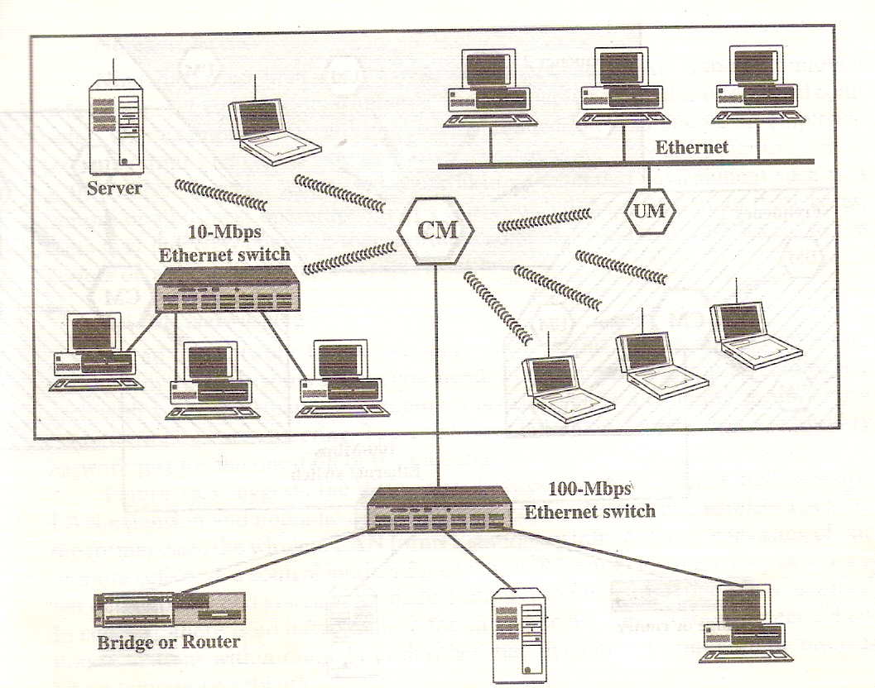
Fig. 2 : Example Single Cell WLAN Configuration

Slide 19
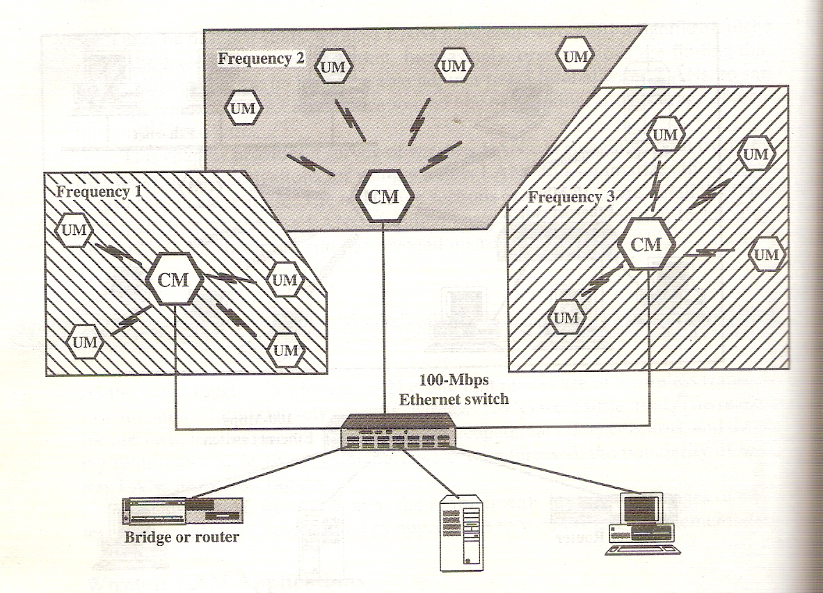
Fig. 3 : Example Multiple-cell WLAN Configuration

Slide 20
Infrastructureless wireless network
A peer-to-peer network (no centralised server) is set up temporarily to meet some immediate need
  eg. A group of employees each with a laptop or palmtop may convene in a conference room for a business
Compared to this network, infrastructure mode networks offer the advantage of scalability, centralized security management and improved reachability
No infrastructure such as cable installation

Slide 21
Infrastructureless wireless network
  eg. Adhoc WLAN
    Unlike infrastructure WLAN there is no infrastructure for this network
    A peer collection of stations within range of each other
    Dynamically configure themselves into a temporary network
  eg. Mobile adhoc network (MANET)
  eg. Wireless sensor network (WSN)

Slide 22
Adhoc WLAN
Allow wireless communication where
  AP is not available
  Access to wired network is not required
Stations on an adhoc WLAN communicate directly with each other
Wireless stations do not connect automatically
To join an adhoc WLAN a node must be configured for adhoc mode
  Same SSID
  Suitable security setting
  Same channel

Slide 23
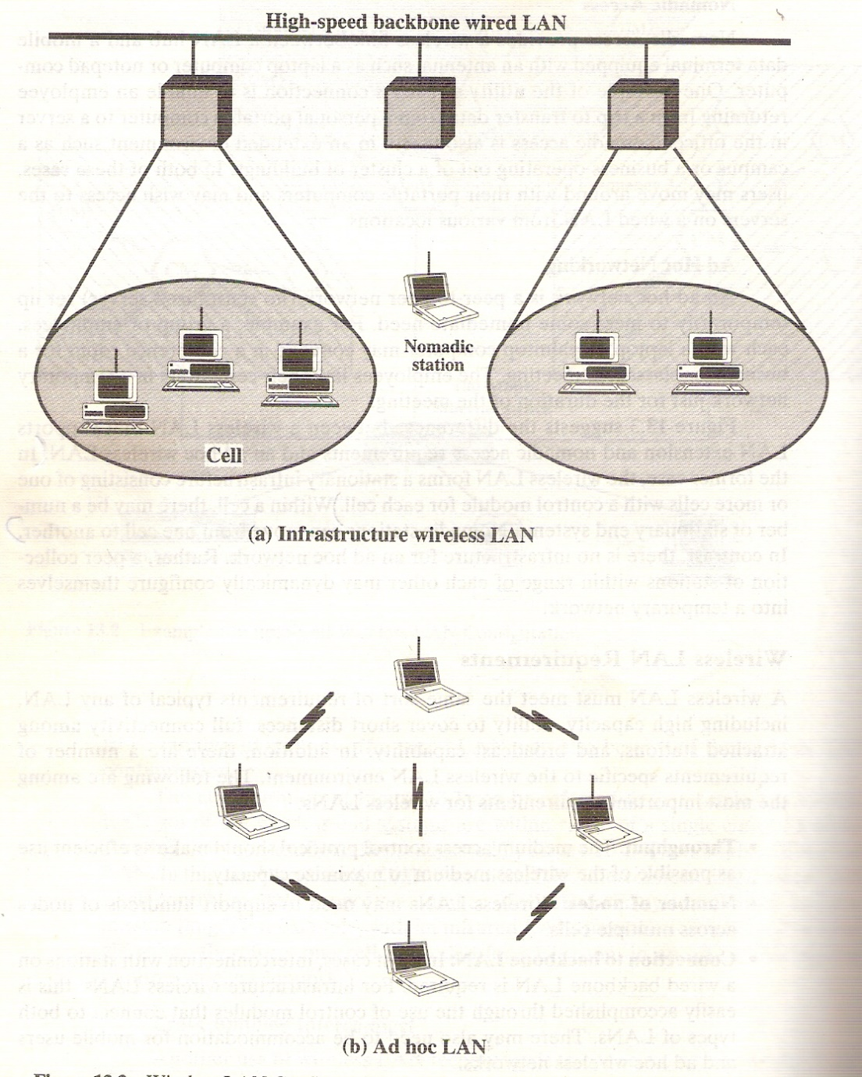
Fig. 4 : WLAN Configurations

Slide 24
MANET
Collection of mobile hosts with wireless network interfaces
Allows users to collaborate in situation without infrastructure
Fast deployable temporary network
Known as Mobile Ad hoc Network (MANET)

Slide 25
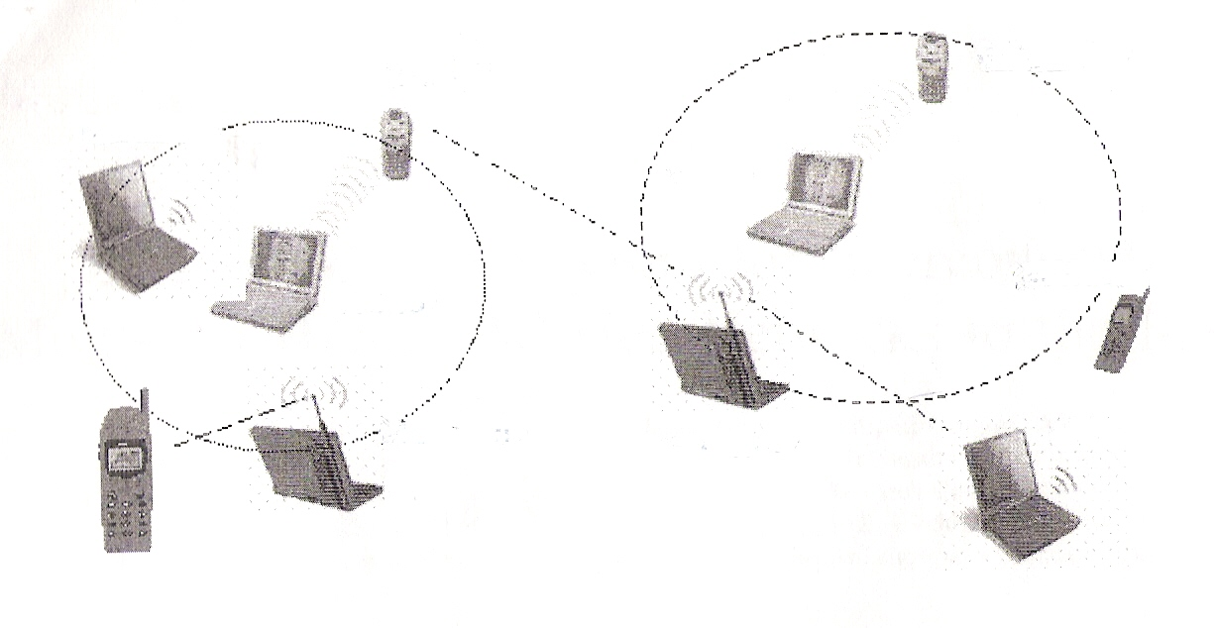
Fig. 5 : Stand-alone MANET

Slide 26
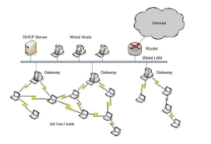
Fig. 6 : Infrastructure MANET

Slide 27
Characteristics
  All nodes are mobile
  Dynamic topology
  Node is both a host and a router
  Multi-hop routing
  Power constraint
  Light-weight terminals
  User driven not data driven

Slide 28
Potential Uses
Any circumstances where mobile access to an infrastructure network is either ineffective or impossible
  Distributed Collaborative Computing
  Disaster Recovery
  Military Settings
  Emergency Search and Rescue
  Environmental Applications

Slide 29
Major Challenges
Issues
  Routing
  Quality of Service (QoS)
  Security
  Constraints
  Mobility
  Lack of infrastructure
  Power

Slide 30
WSN vs. MANET
Wireless sensor networks may be considered a subset of Mobile Ad-hoc NETworks (MANET).
WSN nodes have less power, computation and communication compared to MANET nodes.
MANETs have high degree of mobility, while sensor networks are mostly stationary.
  Freq. node failures in WSN -> topology changes
Routing protocols tend to be complex in MANET, but need to be simple in sensor networks.
Low-power operation is even more critical in WSN.
MANET is address centric, WSN is data centric.

Slide 31
WSN vs. MANET contd.
Diversity of Applications
  No “one fits all” solution exists in WSNs
Density
  several orders of magnitude higher than MANET
Reliability
  WSN nodes more prone to failure
Data Centric
  Address data, not nodes in WSNs
Communication patterns
  One-to-many (broadcast) and many-to-one (aggregation)
Trust
  In-network processing require trust between intermediate nodes

Slide 32
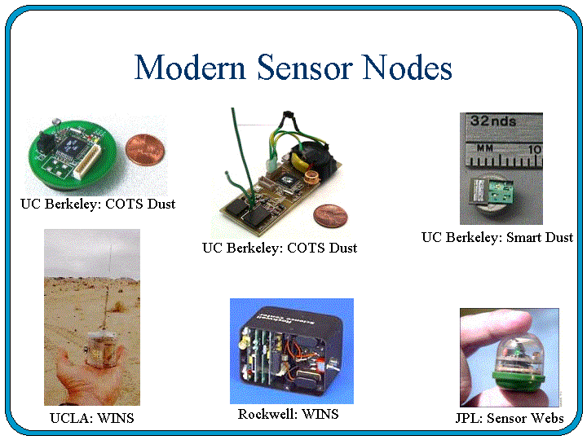

Slide 33
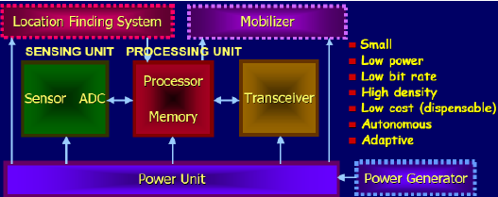
Fig. 7 : Components of WSN

Slide 34
Applications of WSN
Physical security for military operations
Indoor/Outdoor Environmental monitoring
Seismic and structural monitoring
Industrial automation
Bio-medical applications
Health and Wellness Monitoring
Inventory Location Awareness
Future consumer applications, including smart homes.

Slide 35
Characteristics
Deeply distributed architecture: localized coordination to reach entire system goals, no infrastructure with no central control support
Autonomous operation: self-organization, self-configuration, adaptation, exception-free
  TCP/IP is open, widely implemented, supports multiple physical network, relatively efficient and light weight, but requires manual intervention to configure and to use.
Energy conservation: physical, MAC, link, route, application
Scalability: scale with node density, number and kinds of networks
Data centric network: address free route, named data, reinforcement-based adaptation, in-network data aggregation

Slide 36
Challenges
  Limited battery power
  Limited storage and computation
  Lower bandwidth and high error rates
  Scalability to 1000s of nodes
Network Protocol Design Goals
  Operate in self-configured mode (no infrastructure network support)
  Limit memory footprint of protocols
  Limit computation needs of protocols -> simple, yet efficient protocols
  Conserve battery power in all ways possible

Slide 37
Network Architectures
Layered Architecture
Clustered Architecture
Base
Station
Base
Station
Layer 1
Layer 2
Layer 3
Larger Nodes denote Cluster Heads
Fig. 8 : Layered vs. Clustered Architecture

Slide 38
Conclusion
Critics are concerned with
Intrusion of privacy
Younger generation are turning into ‘gizmo freaks’
Becoming addicted to their devices
Pose potential health risks
Concluding remarks
Yet, mobile computing has become an indispensable extension of technology today

